Slide 1
Working Together to Create a Successful Flipped Classroom
Ruth Trygstad and Kristin Cartwright

Slide 2
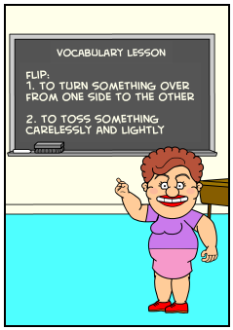
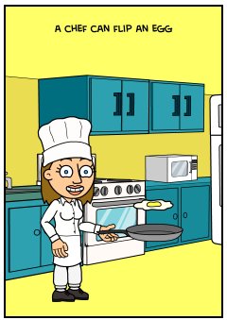
What is this “flipped classroom” I keep hearing about?

Slide 3
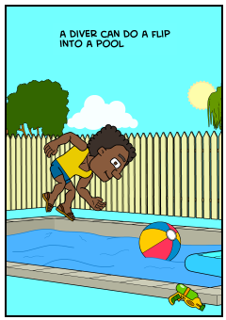
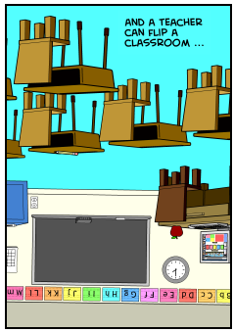
What is this “flipped classroom” I keep hearing about?

Slide 4
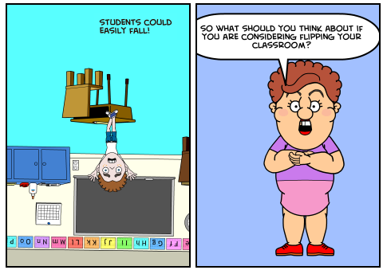
What is this “flipped classroom” I keep hearing about?
*Comic Strip Credit: http://bitstrips.com/r/CXJJS

Slide 5
What is a “flipped classroom”?
?

Slide 6
What is a “flipped classroom”?
Video lectures outside of class
Assigned problems in class
May be “hybrid” – reduced seat time

Slide 7
What we have learned …
and why we almost gave up!

Slide 8
Pilot Spring 2014
“Hybrid College Algebra”
Meet 2 hours per week.
Watch lesson videos before class.
Submit all assignments online.
In class – Q/A & Problem Based Learning

Slide 9
Pilot Spring 2014
“Hybrid College Algebra”
Exams in Testing Center.
Materials & Exams identical to online classes.

Slide 10
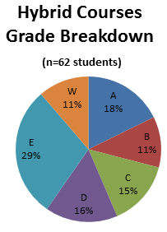
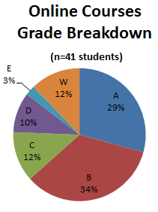
Grade Breakdowns
Notes:
NOTE: 56% of hybrid students received “D”, “E”, or “W” as a final grade, in comparison to 25% of online students.

Slide 11
Pilot Spring 2014
Conclusion
At beginning of course, students were not prepared.
Students did not take responsibility for learning.
Course needed major revisions.

Slide 12
Challenges of a flipped classroom
?

Slide 13
Starting Over – Fall 2014
From assessing weaknesses and strengths of our Spring 2014 Course, we have developed a format that is working much better. . . . .

Slide 14
Getting Class off to a Good Start
Students should be “ready”
Meet prerequisites
Understand format
Have necessary tools

Slide 15
Fall 2014
“Hybrid College Algebra”
An important change:
Early contact with students – one month before class started
Readiness Questionnaire – student response required

Slide 16
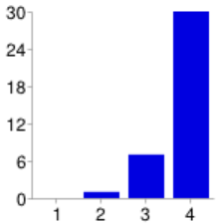
Questionnaire Results
1) How comfortable am I using computers?
79% very confident

Slide 17
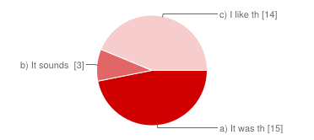
Questionnaire Results
2) I signed up for this hybrid course because:
47%
It was the only one that fit my schedule

Slide 18
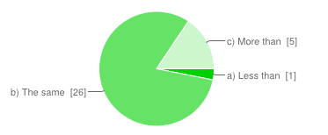
Questionnaire Results
3) The amount of time I have to work on this hybrid course is:
81%
The same as for a traditional class held fully on campus

Slide 19
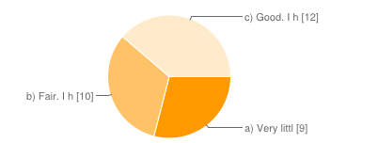
Questionnaire Results
4) My familiarity with online or hybrid courses is:
38% Good. I have taken many online or hybrid courses before

Slide 20
Basic “Outside” Components of a Flipped Classroom
Textbook
Online Course Site
Videos
Online Homework / Quizzes
(All of our materials are OER)

Slide 21

“Outside” Components of our Flipped Classroom
The Textbook:
Free Download
or
$12.61
Ships in 3-5 business days

Slide 22
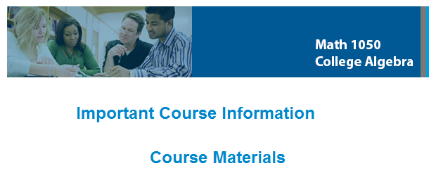
“Outside” Components of our Flipped Classroom
Online course site in Canvas:

Slide 23
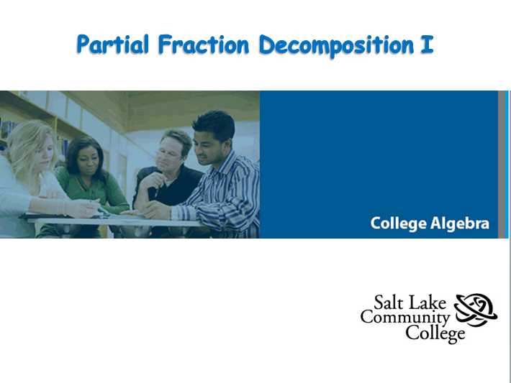
“Outside” Components of our Flipped Classroom
Videos: 1 to 5 per section – 1:46 to 8:39

Slide 24
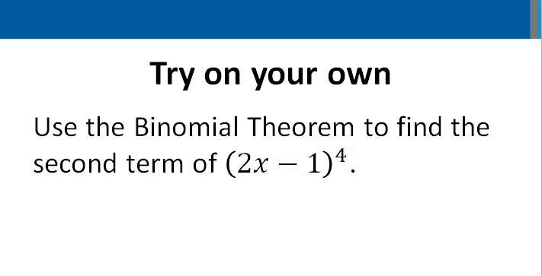
“Outside” Components of our Flipped Classroom
Problems embedded in videos:

Slide 25
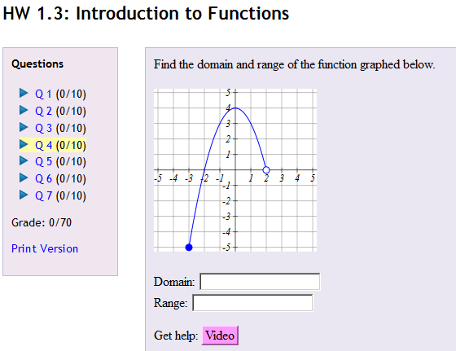
“Outside” Components of our Flipped Classroom
“FREE” online homework
Students like the extra videos!

Slide 26
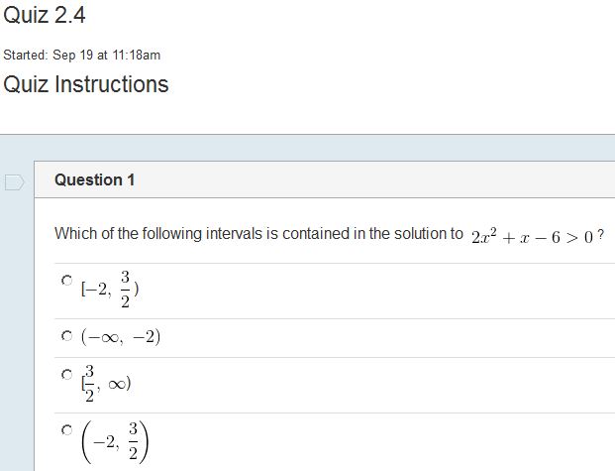
“Outside” Components of our Flipped Classroom
And online quizzes

Slide 27
“In-class” Components of a Flipped Classroom
Assignments
Groups
Instruction

Slide 28
What We Do In Class
First Day of Class:
Introduction
View Questionnaire results
Students are assigned to groups

Slide 29
What We Do In Class
After First Day:
Students watch videos before class.
Students are in groups when class starts.
Time is precious!

Slide 30

What We Do In Class
When class begins: TOYO video problem solutions are on desk

Slide 31
What We Do In Class
Instructor hands out one worksheet to each group.
Groups work together on worksheet.
Instructor moves about room.

Slide 32
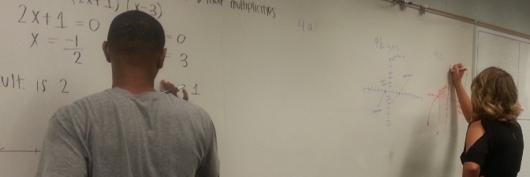
What We Do In Class
Correct solutions are shared on whiteboard.

Slide 33
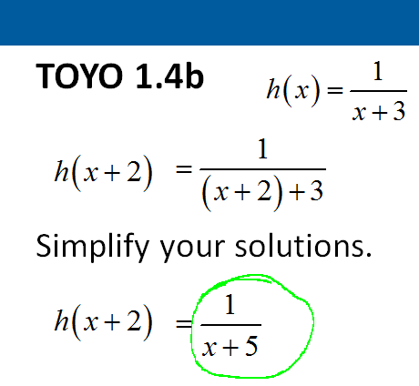
What We Do In Class
Instructor shows PowerPoint of TOYO solutions. Students grade their own.

Slide 34
What We Do In Class
End of class:
Groups turn in worksheets.
Students staple and turn in graded TOYO solutions.

Slide 35
Outside of Class
Watch videos and complete TOYO’s.
Online homework is due Friday by 11:59 PM.
Online quizzes are due Monday by 11:59 PM.

Slide 36
Results This Semester
Positive, relaxed, classroom learning environment
Few drops
Positive student feedback

Slide 37
Fall 2014
Statistics so far …

Slide 38
Fall 2014
Statistics so far …

Slide 39
Fall 2014
Statistics so far …

Slide 40
Fall 2014
Statistics so far …

Slide 41
Fall 2014
Student Comments
“It’s a lot more work than I thought.”
“I like that we learn before coming to class. It has helped me to understand math which is a big deal because I am terrible at math.”

Slide 42
Fall 2014
Student Comments
“Better for a busy schedule, requires a lot of self motivation like an online class, but better because you can still bounce your ideas off of other classmates.”

Slide 43
Fall 2014
Student Comments
“This class has helped me build my personal determination and desire to learn and understand math. Because I do so much on my own, it’s helped me more thoroughly understand the laws of math.”

Slide 44
Fall 2014
Student Comments
“Prepping at home allows me to watch a lecture as many times as I need and build my confidence without the embarrassment and pressure of asking questions or being put on the spot mid-lecture.”

Slide 45
Summary
“By removing the ‘one-size-fits-all’ lecture from the classroom, and letting the students have a self-paced lecture at home –

Slide 46
Summary
and then when you go to the classroom, letting them do work, having the teacher walk around, having the peers actually interacting with each other –

Slide 47
Summary
these teachers have used TECHNOLOGY to HUMANIZE the classroom.”
– Salman Khan (creator of Khan Academy)

Slide 48
Thanks for attending!
Kristin Cartwright
Kristin.Cartwright@slcc.edu
Ruth Trygstad
Ruth.Trygstad@slcc.edu

